Slide 1
机器人与人工智能实验室 Robotics and Artificial Intelligence Laboratory
WELCOME TO

Slide 2
Buzzer Music Composing
1. Introduction
The analogWrite function can change the effective voltage by changing the duty cycle of the PWM wave. In a for loop, the amp and the voltage of the buzzer are constantly increasing. Therefore, the tone of meow changes.

Slide 3
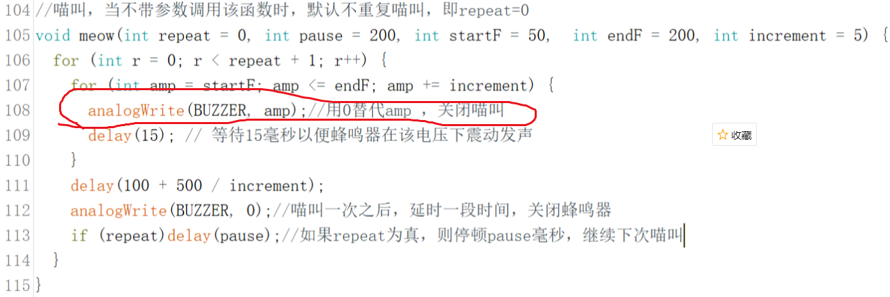
Buzzer Music Composing

Slide 4
Buzzer Music Composing
2. Tone()
The tone() function can generate a fixed frequency PWM signal to drive the speaker to sound. The duration and tone of voice can be controlled by parameters.
There are two ways to define the duration of sounding. The first is through the parameters of the tone() function. The other is to use the notone() function to stop the sound.
If the tone() function is used without defining the duration of sounding, Arduino will always generate a sound signal through the tone() function unless the sound is stopped by the notone() function.

Slide 5
Buzzer Music Composing
3. Syntax
tone(pin, frequency)
tone(pin, frequency, duration)
4. Parameter:
Pin: sounding pin (the pin is connected to the buzzer)
Frequency: sounding frequency (in Hertz) - unsigned integer
Duration: duration (in microseconds, this parameter is optional) - unsigned long integer

Slide 6
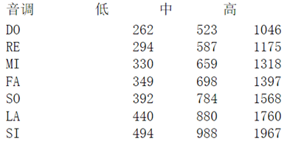
Buzzer Music Composing
When calling the tone() function, it is best to take the duration parameter.
The corresponding relationship between the tone of the simplified spectrum and the mechanical vibration frequency is as follows.

Slide 7
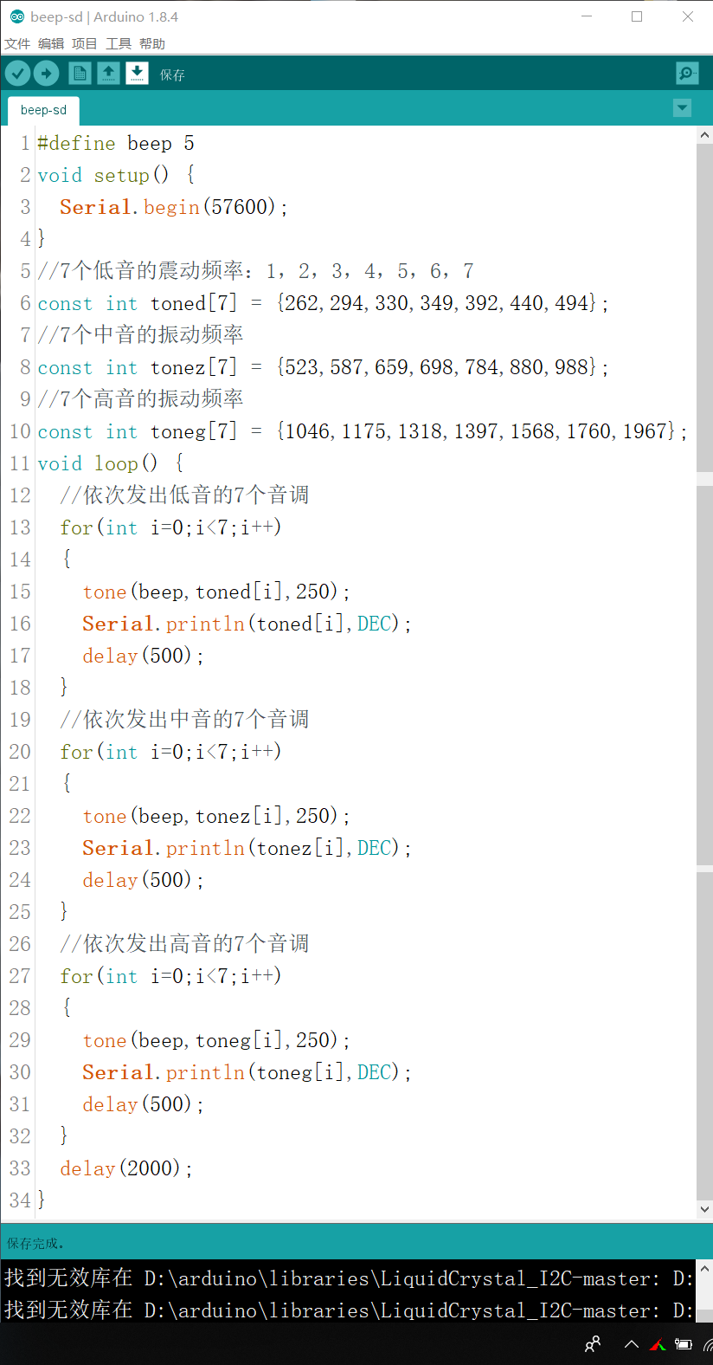
Buzzer Music Composing
Use tone() function to produce the tones of scales of low, medium and high.
But not nice

Slide 8
Buzzer Music Composing

Slide 9
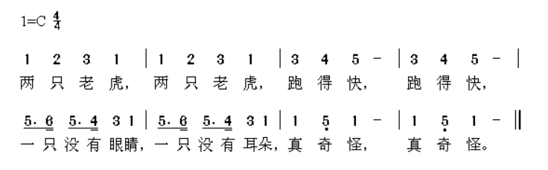
Buzzer Music Composing
Notation of a Song

Slide 10
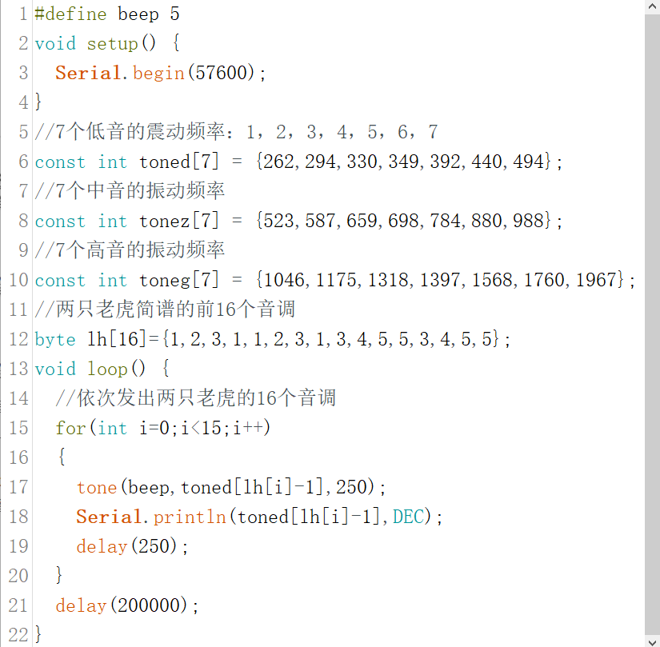
Buzzer Music Composing
This is the specific program, which stores the simplified notation in the lh[16] array

Slide 11

THANK YOU
林天麟 教授
香港中文大学（深圳）
机器人与人工智能实验室
WeChat: tinlunlam

